Slide 1
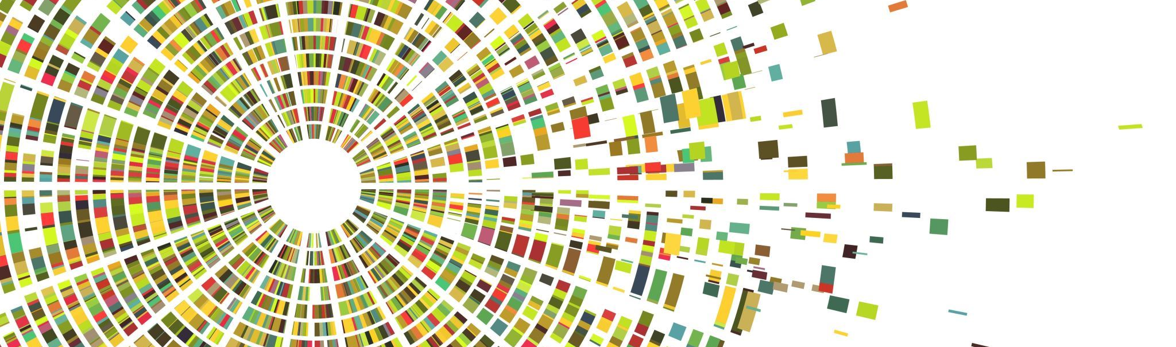
PLANT DISEASE DETECTION

Slide 2
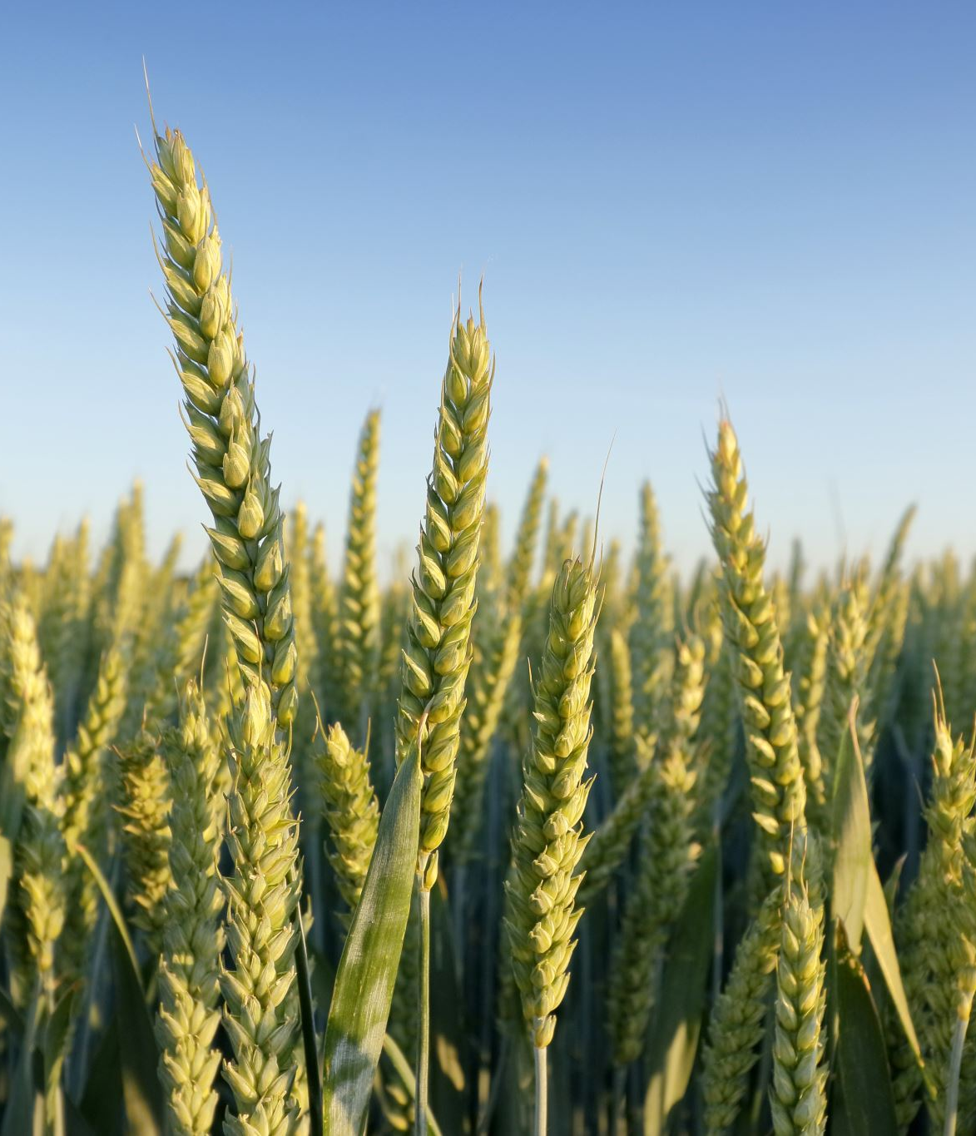
PROBLEM STATEMENT
DISEASES IN AGRICULTURE PLANTS AND HOW WE CAN HELP THE FARMERS TO KNOW ABOUT THE PROBLEM

Slide 3

REQUIREMENTS
A MOBILE PHONE WITH CAMERA, AN APPLICATION WITH TRAINED MODEL

Slide 4
TECHNOLOGIES USED
PYTHON WITH LIBRARIES NAMED AS KERAS,MATPLOTLIB
KAGGLE PLANT DATASET

Slide 5
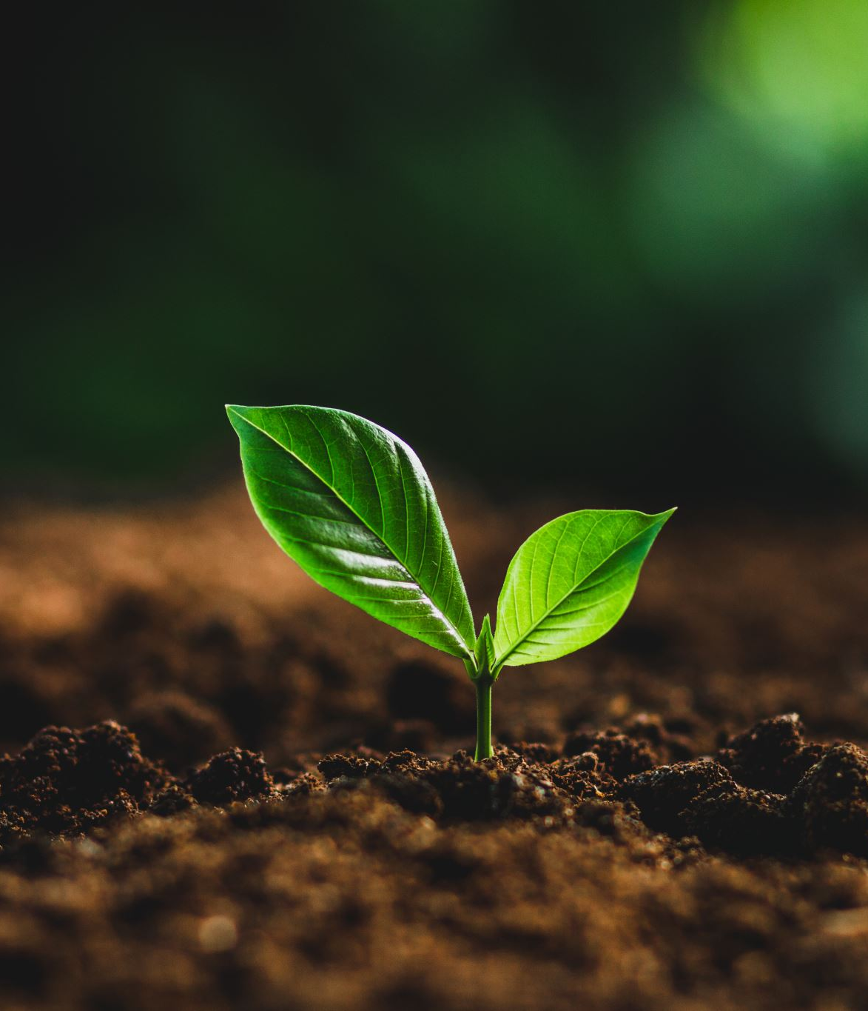
PROJECT DESCRIPTION
THIS MODEL WILL TAKE AN INPUT IMAGE FROM THE USER AND ANALIZE IT AFTER THATB IT WILL TELL YOU USER THAT WHAT DISEASE IF PLANT SUFFERING FROM.IT WILL HELP THE FARMERS TO KNOW ABOUT THE DISEASE AND THEY WILL GET CURE OF IT FROM MEDICAL SHOP

Slide 6

SCOPE
IT AUTOMATICALLY IDENTIFY DISEASES IN THE PLANT WHICH WILL HELP FARMER TO GET RIGHT TREATMENT FOR THEIR PLANTS

Slide 7

CHALLENGES FACED
IT WAS HARD TO GET THE DATASET FROM THE INTERNET

Slide 8
CONCLUSION
AFTER THIS HARD WORK FINALLY WE DEVELOPED A METHOD IN WHICH WE GIVE DATASET TO OUR ALORITHMS THEN IT TRAIN A MODEL ON THAT DATASETBY USING CONVOLUTIONAL NEURAL NETWORK

